Slide 1

Meta HR Management
Prepared by Roatny
Date: 31st Jan.2023

Slide 2
Content
Meta Culture
Meta Six Core Values
How they impower their employees

Slide 3
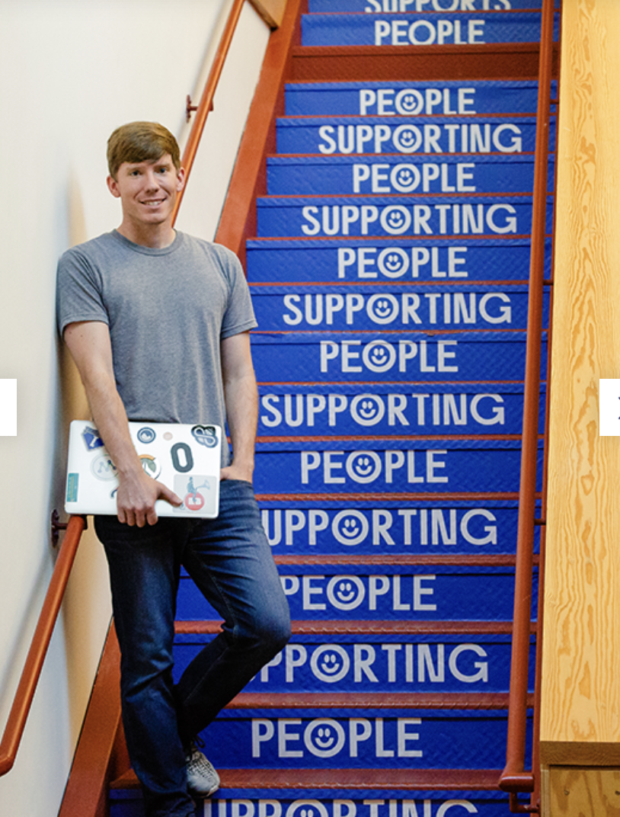
Meta Culture
Move Fast. Be Yourself
Empower people to connect with each other
Build community
Do work that is meaningful for them, for company, and for the people who use our technologies.

Slide 4
Six Core Values
Move Fast
Focus on Long-Term Impact
Build Awesome Things
Live in the Future
Be Direct and Respect Your Colleagues
Meta, Metamates, Me

Slide 5

What we are good at:

Slide 6
Meta Employees in 2022
87,000+
Employees
Why Should I work here?
Global Data

Slide 7

Work Where & How You Work Best

Slide 8
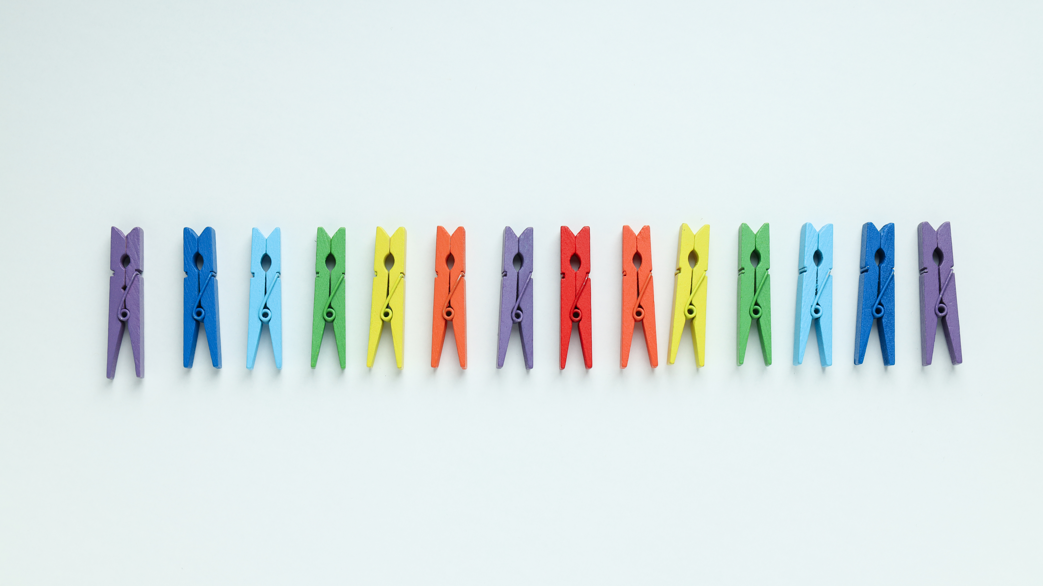
Equal Employment Opportunity & Affirmative Action employer
Equal Employment
Criminal histories, consistent with applicable federal, state and local law.

Slide 9
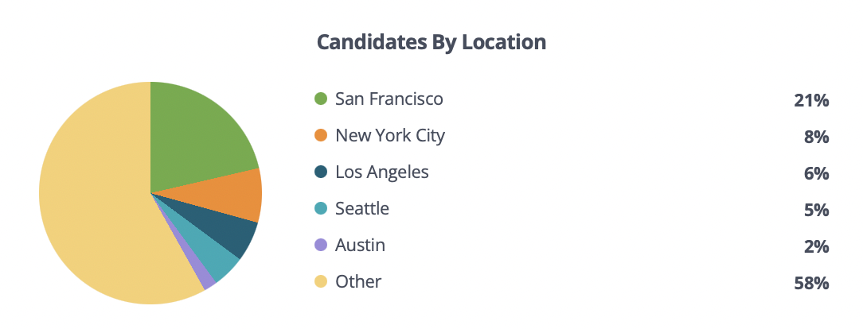
Why is it Equal?

Slide 10
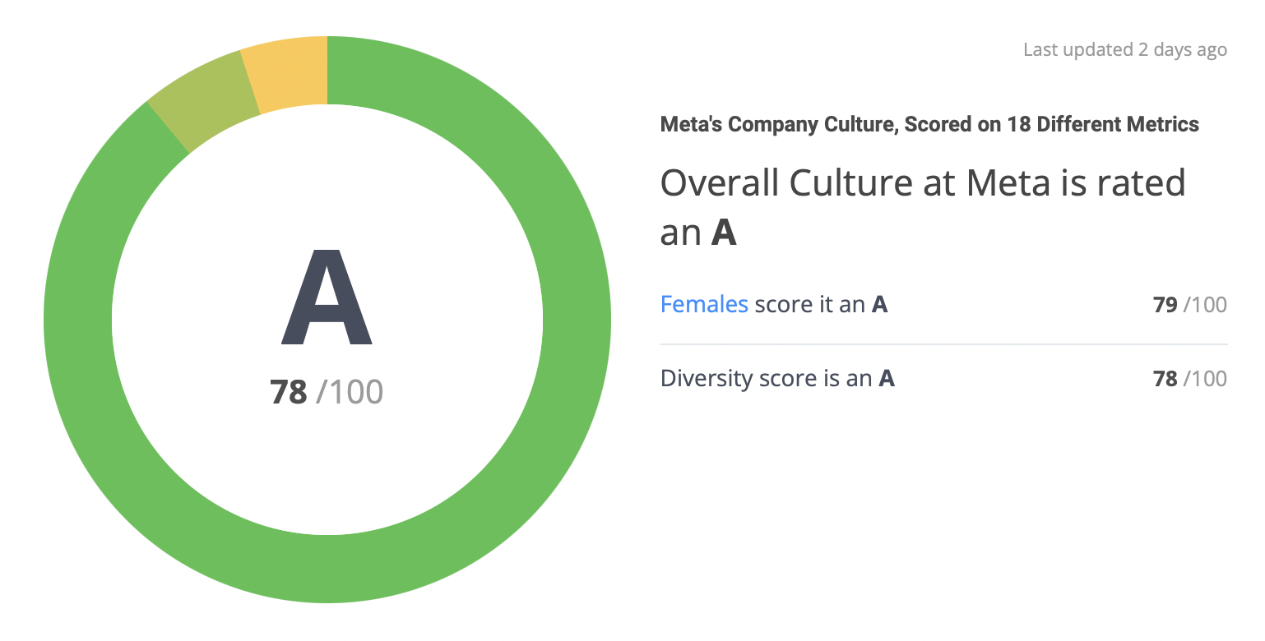
Should I work at Meta?
By Comparably

Slide 11

Top 5 culture dimensions
Perks And Benefits
Compensation
And Happiness.

Slide 12

Transparent feel valued and trusted
Facebookers say that working with smart co-workers motivates them to keep up their A game.

Slide 13
Salary Rate
Average
$140,602/y
or $67/hour
Median:
$149,718/y
or $71/ hour

Slide 14
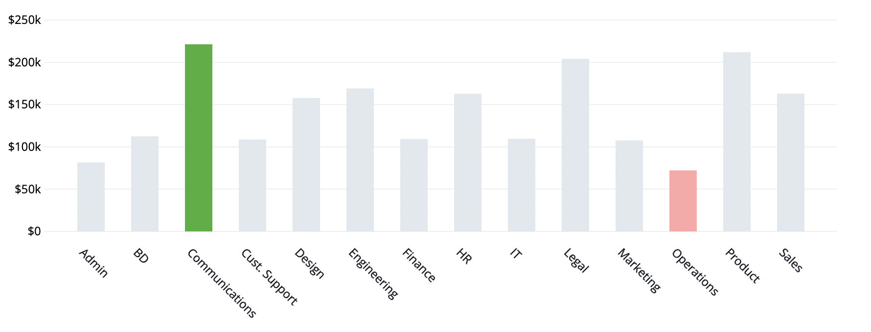
Meta Salary Averages By Department

Slide 15

THANK YOU!

